Slide 1
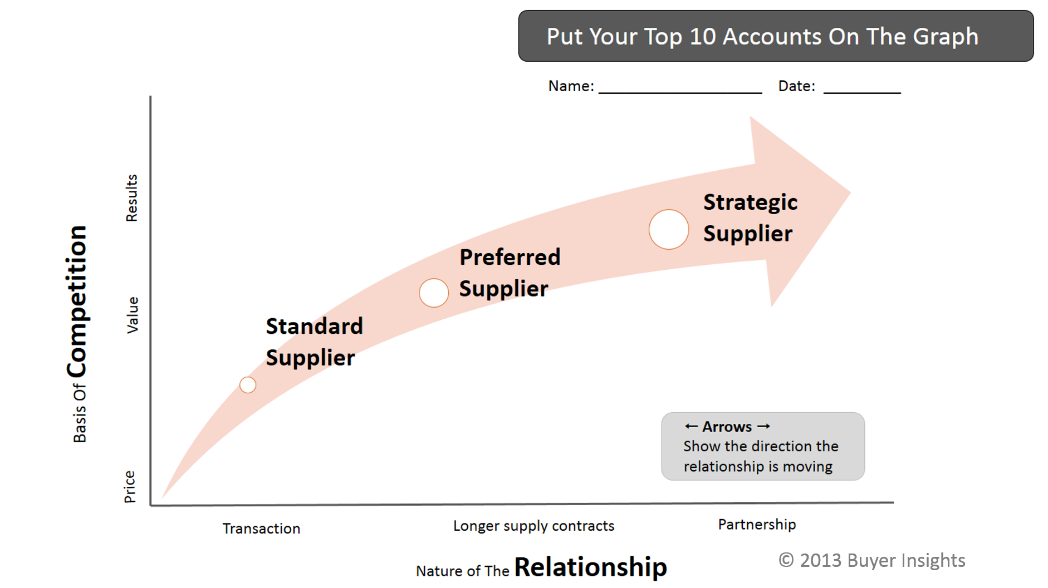
Copy this and use it
<- Company Name ->

